Slide 1
  Part1 : Cryptography
  (symmetric key)
1

Slide 2
Roadmap
Symmetric encryption
Classical substitution ciphers
Crypto analysis
One time pad
DES
Modes of operation
Triple DES
AES
Stream Cipher(RC4)

Slide 3
Symmetric encryption
also known as conventional / private-key / single-key
sender and recipient share a common key
all classical encryption algorithms are private-key
was only type prior to invention of public-key in 1970’s

Slide 4

Symmetric encryption

Slide 5
Symmetric encryption
two requirements for secure use of symmetric encryption:
  a strong encryption algorithm
  a secret key known only to sender / receiver
mathematically have:
  Y = E_{K}(X)
  X = D_{K}(Y)
assume encryption algorithm is known
implies a secure channel to distribute key

Slide 6
Classical substitution ciphers
where letters of plaintext are replaced by other letters or by numbers or symbols
or if plaintext is viewed as a sequence of bits, then substitution involves replacing plaintext bit patterns with ciphertext bit patterns

Slide 7
Caesar Cipher
earliest known substitution cipher
by Julius Caesar
first attested use in military affairs
replaces each letter by 3rd letter on
example:
  meet me after the toga party
  PHHW PH DIWHU WKH WRJD SDUWB

Slide 8
Caesar Cipher
can define transformation as:
  a b c d e f g h i j k l m n o p q r s t u v w x y z
  D E F G H I J K L M N O P Q R S T U V W X Y Z A B C
mathematically give each letter a number
  a b c d e f g h i j k l m n o p q r s t u v w x y z
  0 1 2 3 4 5 6 7 8 9 10 11 12 13 14 15 16 17 18 19 20 21 22 23 24 25
then have Caesar cipher as:
  c = E(p) = (p + k) mod (26)
  p = D(c) = (c – k) mod (26)

Slide 9
Caesar Cipher
Limitations
  only have 26 possible ciphers
    A maps to A,B,..Z
  could simply try each in turn
  a brute force search
  given ciphertext, just try all shifts of letters

Slide 10

Caesar Cipher
limitations

Slide 11
Crypto analysis
objective to recover key not just message
general approaches:
  cryptanalytic attack
  brute-force attack

Slide 12
One time pad
if a truly random key as long as the message is used, the cipher will be secure
called a One-Time pad
is unbreakable since ciphertext bears no statistical relationship to the plaintext
since for any plaintext & any ciphertext there exists a key mapping one to other
can only use the key once though
problems in generation & safe distribution of key

Slide 13
One time pad
example
  m = “transfer 10,000won from Bob to Alice”
  m = “1110100 1110010 … 1100101”
  XOR above message with a random string of same size, called one time pad, OTP → key
  OTP=“0011010 1101101 … 0011011”
  E(m)=m XOR OTP
  =“1110100 1110010 … 1100101”
  XOR “0011010 1101101 … 0011011”
  = “1101110 0011111 … 1111110”

Slide 14
One time pad
    m = “1110100 1110010 … 1100101”
    OTP=“0011010 1101101 … 0011011”
    E(m)= “1101110 0011111 … 1111110”
    D(E(m))=E(m) XOR OTP
    = “1101110 0011111 … 1111110”
    XOR “0011010 1101101 … 0011011”
    = “1110100 1110010 … 1100101”
    =m
    Why?
      A XOR A XOR B= B

Slide 15
One time pad
    Why?
      “A XOR A XOR B” becomes “B”
      A=0
        A XOR ‘0’ = ‘0’, A XOR ‘0’ XOR A = ‘0’ XOR ‘0’ = ‘0’
        A XOR ‘1’ = ‘1’, A XOR ‘1’ XOR A = ‘1’ XOR ‘0’ = ‘1’
      A=1
        A XOR ‘0’ = ‘1’, A XOR ‘0’ XOR A = ‘1’ XOR ‘1’ = ‘0’
        A XOR ‘1’ = ‘0’, A XOR ‘1’ XOR A = ‘0’ XOR ‘1’ = ‘1’
      → A XOR B XOR A = B

Slide 16
DES
Symmetric key
  Block cipher v.s. Streaming cipher
  Block cipher
    DES, AES
  Streaming cipher
    RC4

Slide 17
DES
now look at modern block ciphers
one of the most widely used types of cryptographic algorithms
provide secrecy /authentication services
focus on DES (Data Encryption Standard)
to illustrate block cipher design principles

Slide 18
DES
block ciphers process messages in blocks, each of which is then en/decrypted
like a substitution on very big characters
  64-bits or more
stream ciphers process messages a bit or byte at a time when en/decrypting

Slide 19
DES
adopted in 1977 by NBS (now NIST)
  as FIPS PUB 46
encrypts 64-bit data using 56-bit key
  not secure any more
  brute force search and crypto analysis

Slide 20

DES
-initial permutation
-16 identical “rounds” of function application, each using different 48 bits of key
-final permutation

Slide 21
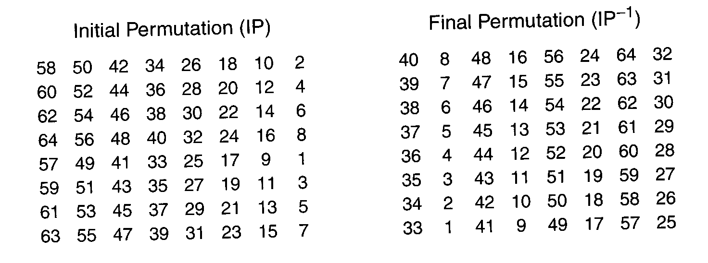
DES
permutation

Slide 22
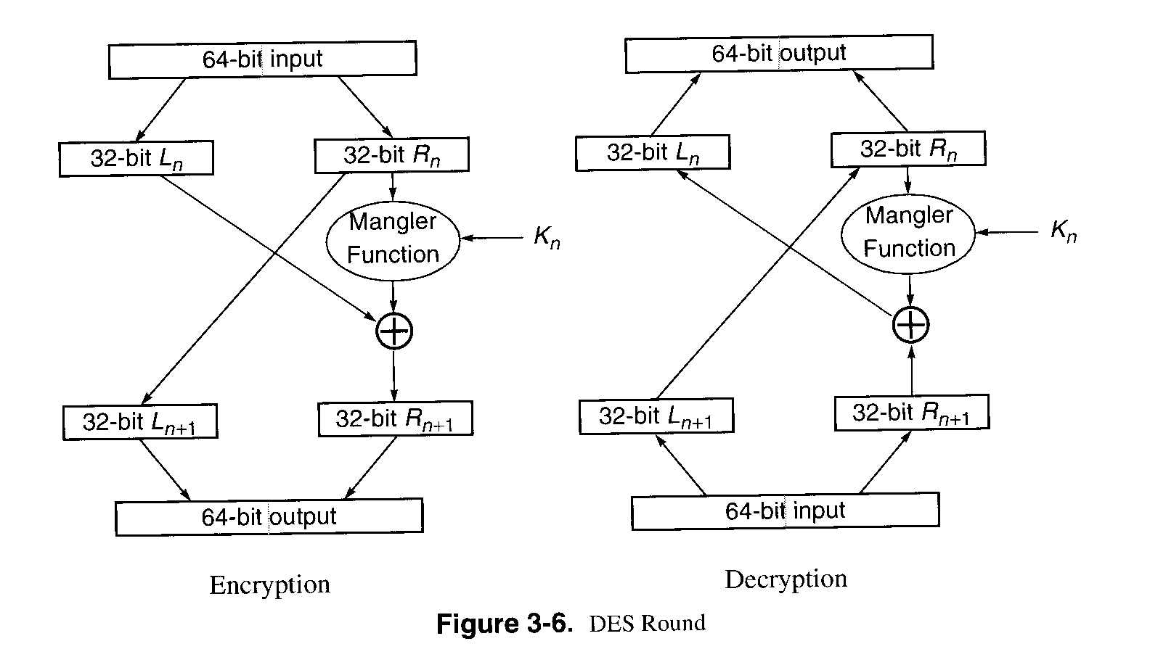
DES
DES round
uses two 32-bit L & R halves
as for any Feistel cipher can describe as:
  L_{i} = R_{i–1}
  R_{i} = L_{i–1} ⊕ F(R_{i–1}, K_{i})
F takes 32-bit R half and 48-bit subkey:
  expands R to 48-bits using perm E
  adds to subkey using XOR
  passes through 8 S-boxes to get 32-bit result
  finally permutes using 32-bit perm P

Slide 23

DES
mangler function
  Substitution boxes Si
  ex)S(18 09 12 3d 11 17 38 39) = 5fd25e03

Slide 24
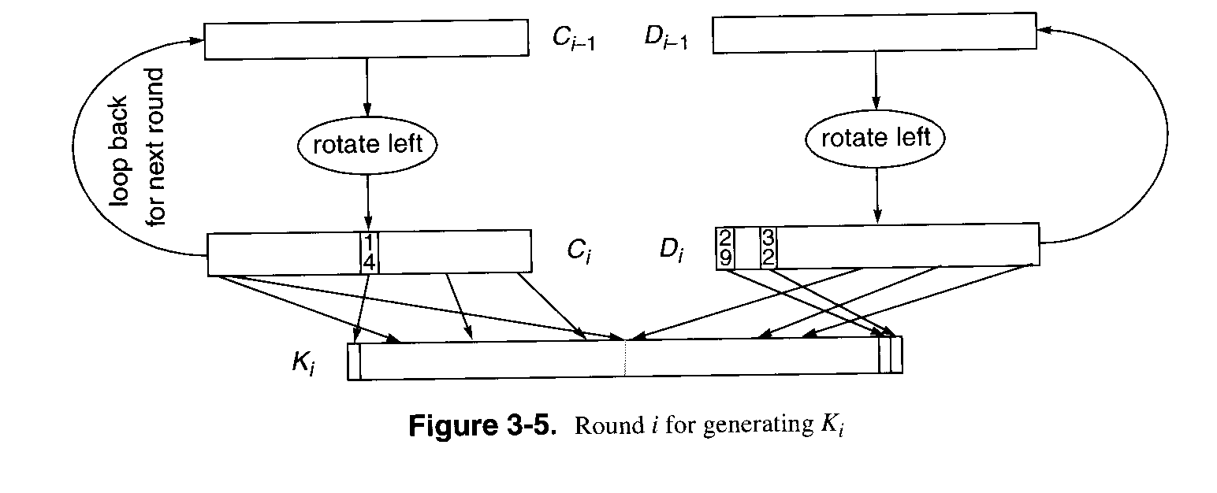
DES
Subkey generation function

Slide 25
DES
56-bit keys have 2⁵⁶ = 7.2 x 10¹⁶ values
brute force search looks hard
recent advances have shown is possible
  in 1997 on Internet in a few months
  in 1998 on dedicated h/w (EFF) in a few days
  in 1999 above combined in 22hrs!
must now consider alternatives to DES
  Triple DES
  Advanced Encryption Standard(AES)

Slide 26
Modes of operation
Encrypting Large Message
  Electronic Code Book (ECB)
  Cipher Block Chaining (CBC)

Slide 27
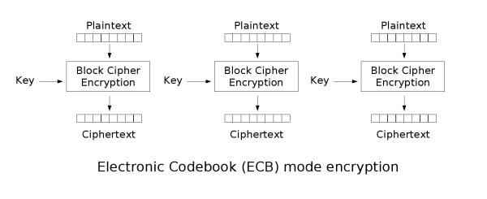
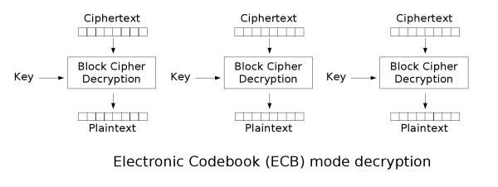
Modes of operation
Electronic Code Book
  Identical ciphertext blocks for identical message blocks
  Predictable outcome by exchanging ciphertextblocks
  problem?

Slide 28
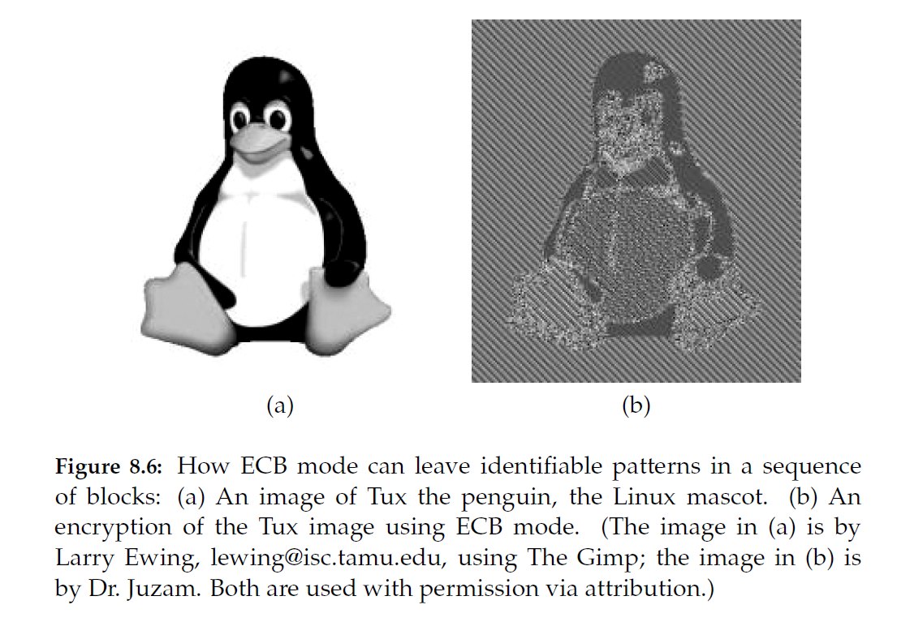
Modes of operation
Strengths and weaknesses of ECB
Weakness:
  Documents and images are not suitable for ECB encryption since patters in the plaintext are repeated in the ciphertext:
Strengths:
  Is very simple
  Allows for parallel encryptions of the blocks of a plaintext
  Can tolerate the loss or damage of a block

Slide 29
Modes of operation
Cipher Block Chaining (CBC)
  a ciphertext block depends on all blocks before it
  any change to a block affects all following ciphertext blocks
  C[i] = E_{K} (C[i −1] ⊕ P[i])
  P[i] = C[i −1] ⊕ D_{K} (C[i])
CBC Encryption:
CBC Decryption:
P[0]
P[1]
P[2]
P[3]
P[0]
P[1]
P[2]
P[3]
E_{K}
E_{K}
E_{K}
E_{K}
D_{K}
D_{K}
D_{K}
D_{K}
C[0]
C[1]
C[2]
C[3]
C[0]
C[1]
C[2]
C[3]

Slide 30
Modes of operation
Initialization Vector (IV)
    C[−1] = V, a random block separately transmitted encrypted (known as the initialization vector)
  Why?
CBC Encryption:
CBC Decryption:
P[0]
P[1]
P[2]
P[3]
P[0]
P[1]
P[2]
P[3]
IV
IV
E_{K}
E_{K}
E_{K}
E_{K}
D_{K}
D_{K}
D_{K}
D_{K}
C[0]
C[1]
C[2]
C[3]
C[0]
C[1]
C[2]
C[3]

Slide 31
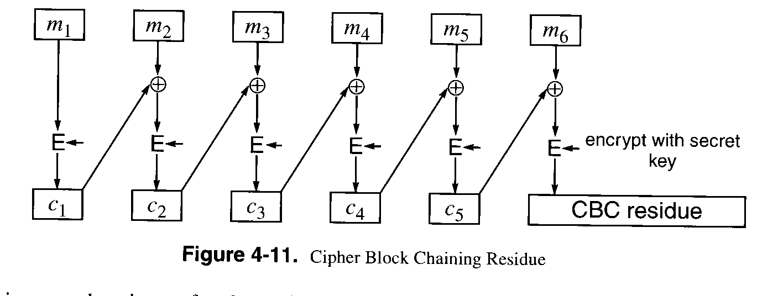
Encrypting Large Message
Message Authentication Code(MAC)
  The value of MAC is dependent on all message blocks and their order.

Slide 32
Triple DES
Triple DES
  Key size 64bits → 128bits
  M -> E(k1) -> E(k2) -> E(k3) -> C
  Two keys are enough
  M -> E(k1) -> D(k2) -> E(k1) -> C (encryption)
  C -> D(k1) -> E(k2) -> D(k1) -> m (decryption)

Slide 33
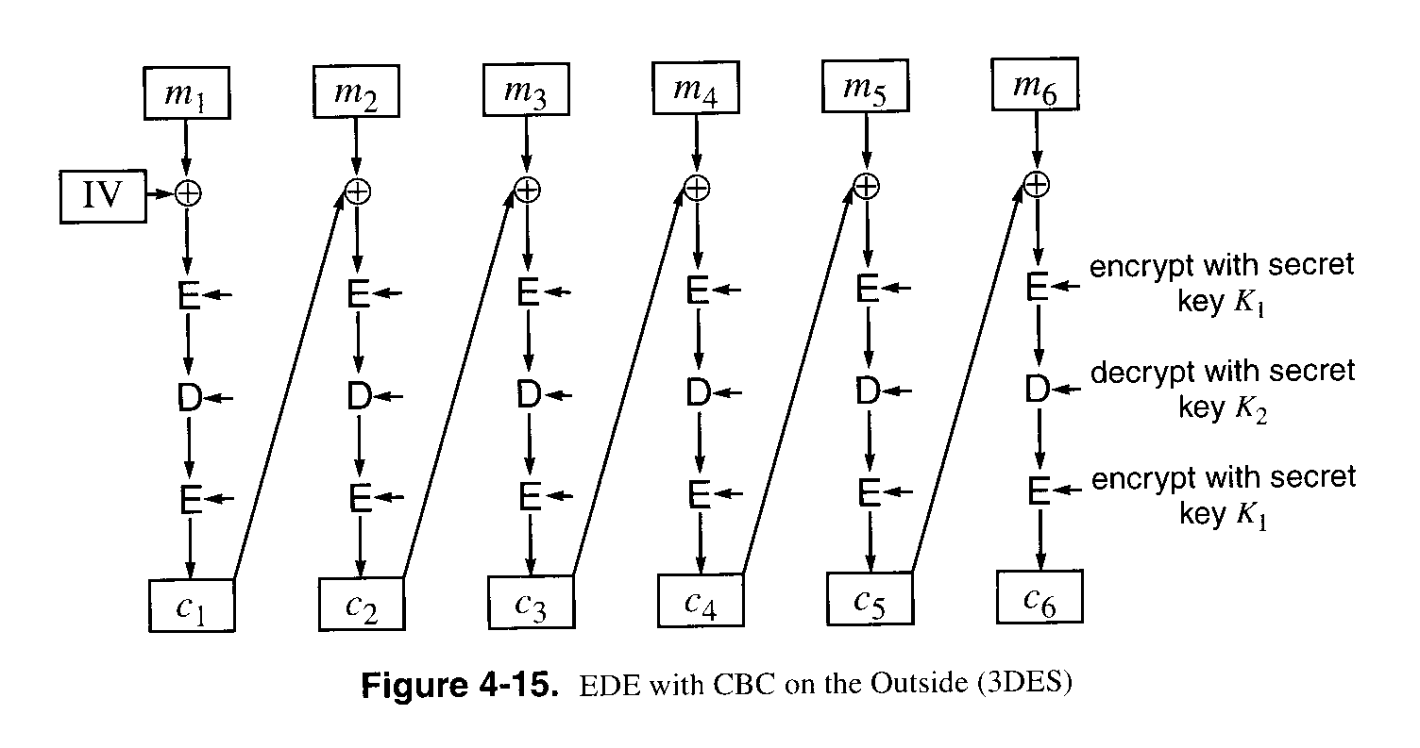
Triple DES

Slide 34
AES
Advanced Encryption Standard
clear a replacement for DES was needed
  have theoretical attacks that can break it
  have demonstrated exhaustive key search attacks
can use Triple-DES – but slow, has small blocks
US NIST issued call for ciphers in 1997
15 candidates accepted in Jun 98
5 were shortlisted in Aug-99
Rijndael was selected as the AES in Oct-2000
issued as FIPS PUB 197 standard in Nov-2001

Slide 35
AES
private key symmetric block cipher
128-bit data, 128/192/256-bit keys
stronger & faster than Triple-DES
active life of 20-30 years (+ archival use)
provide full specification & design details
both C & Java implementations
NIST have released all submissions & unclassified analyses

Slide 36
AES
after testing and evaluation, shortlist in Aug-99:
  MARS (IBM) - complex, fast, high security margin
  RC6 (USA) - v. simple, v. fast, low security margin
  Rijndael (Belgium) - clean, fast, good security margin
  Serpent (Euro) - slow, clean, v. high security margin
  Twofish (USA) - complex, v. fast, high security margin

Slide 37

AES

Slide 38
Padding
Padding
  PKCS#5 padding
    PKCS#5: Password-based Encryption Standard
    PKCS(Public-Key Cryptography Standards) by RSA Security Inc.
Requires padding
with extra bits.
Plaintext
Blocks of
plaintext

Slide 39
Padding
PKCS5Padding schema is actually very simple. It follows the following rules:
  The number of bytes to be padded equals to "8 - numberOfBytes(clearText) mod 8". So 1 to 8 bytes will be padded to the clear text data depending on the length of the clear text data.
  All padded bytes have the same value - the number of bytes padded.
PKCS5Padding schema can also be explained with the diagram below, if M is the original clear text and PM is the padded clear text:
  If numberOfBytes(clearText) mod 8 == 7, PM = M + 0x01
  If numberOfBytes(clearText) mod 8 == 6, PM = M + 0x0202
  If numberOfBytes(clearText) mod 8 == 5, PM = M + 0x030303
  ...
  If numberOfBytes(clearText) mod 8 == 0, PM = M + 0x0808080808080808
http://www.herongyang.com/Cryptography/DES-JDK-What-Is-PKCS5Padding.html

Slide 40
Stream cipher(RC4)
One-time pad, generated by a stream cipher, which is essentially a random number generator
process message bit by bit (as a stream)
have a pseudo random keystream
combined (XOR) with plaintext bit by bit
randomness of stream key completely destroys statistically properties in message
  C_{i} = M_{i} XOR StreamKey_{i}
  one time pad

Slide 41

Stream cipher(RC4)

Slide 42
Stream cipher(RC4)
some design considerations are:
  long period with no repetitions
  statistically random
  depends on large enough key
  large linear complexity
properly designed, can be as secure as a block cipher with same size key
but usually simpler & faster

Slide 43
Stream cipher(RC4)
RC4
  a proprietary cipher owned by RSA DSI
  another Ron Rivest design, simple but effective
  variable key size, byte-oriented stream cipher
  widely used (web SSL/TLS, wireless WEP)
  key forms random permutation of all 8-bit values
  uses that permutation to scramble input info processed a byte at a time

Slide 44
Stream cipher(RC4)
starts with an array S of numbers: 0..255
use key to well and truly shuffle
S forms internal state of the cipher
  for i = 0 to 255 do
    S[i] = i
    T[i] = K[i mod keylen])
  j = 0
  for i = 0 to 255 do
    j = (j + S[i] + T[i]) (mod 256)
    swap (S[i], S[j])

Slide 45
Stream cipher(RC4)
encryption continues shuffling array values
sum of shuffled pair selects "stream key" value from permutation
XOR S[t] with next byte of message to en/decrypt
  i = j = 0
  for each message byte M_{i}
    i = (i + 1) (mod 256)
    j = (j + S[i]) (mod 256)
    swap(S[i], S[j])
    t = (S[i] + S[j]) (mod 256)
    C_{i} = M_{i} XOR S[t]

Slide 46
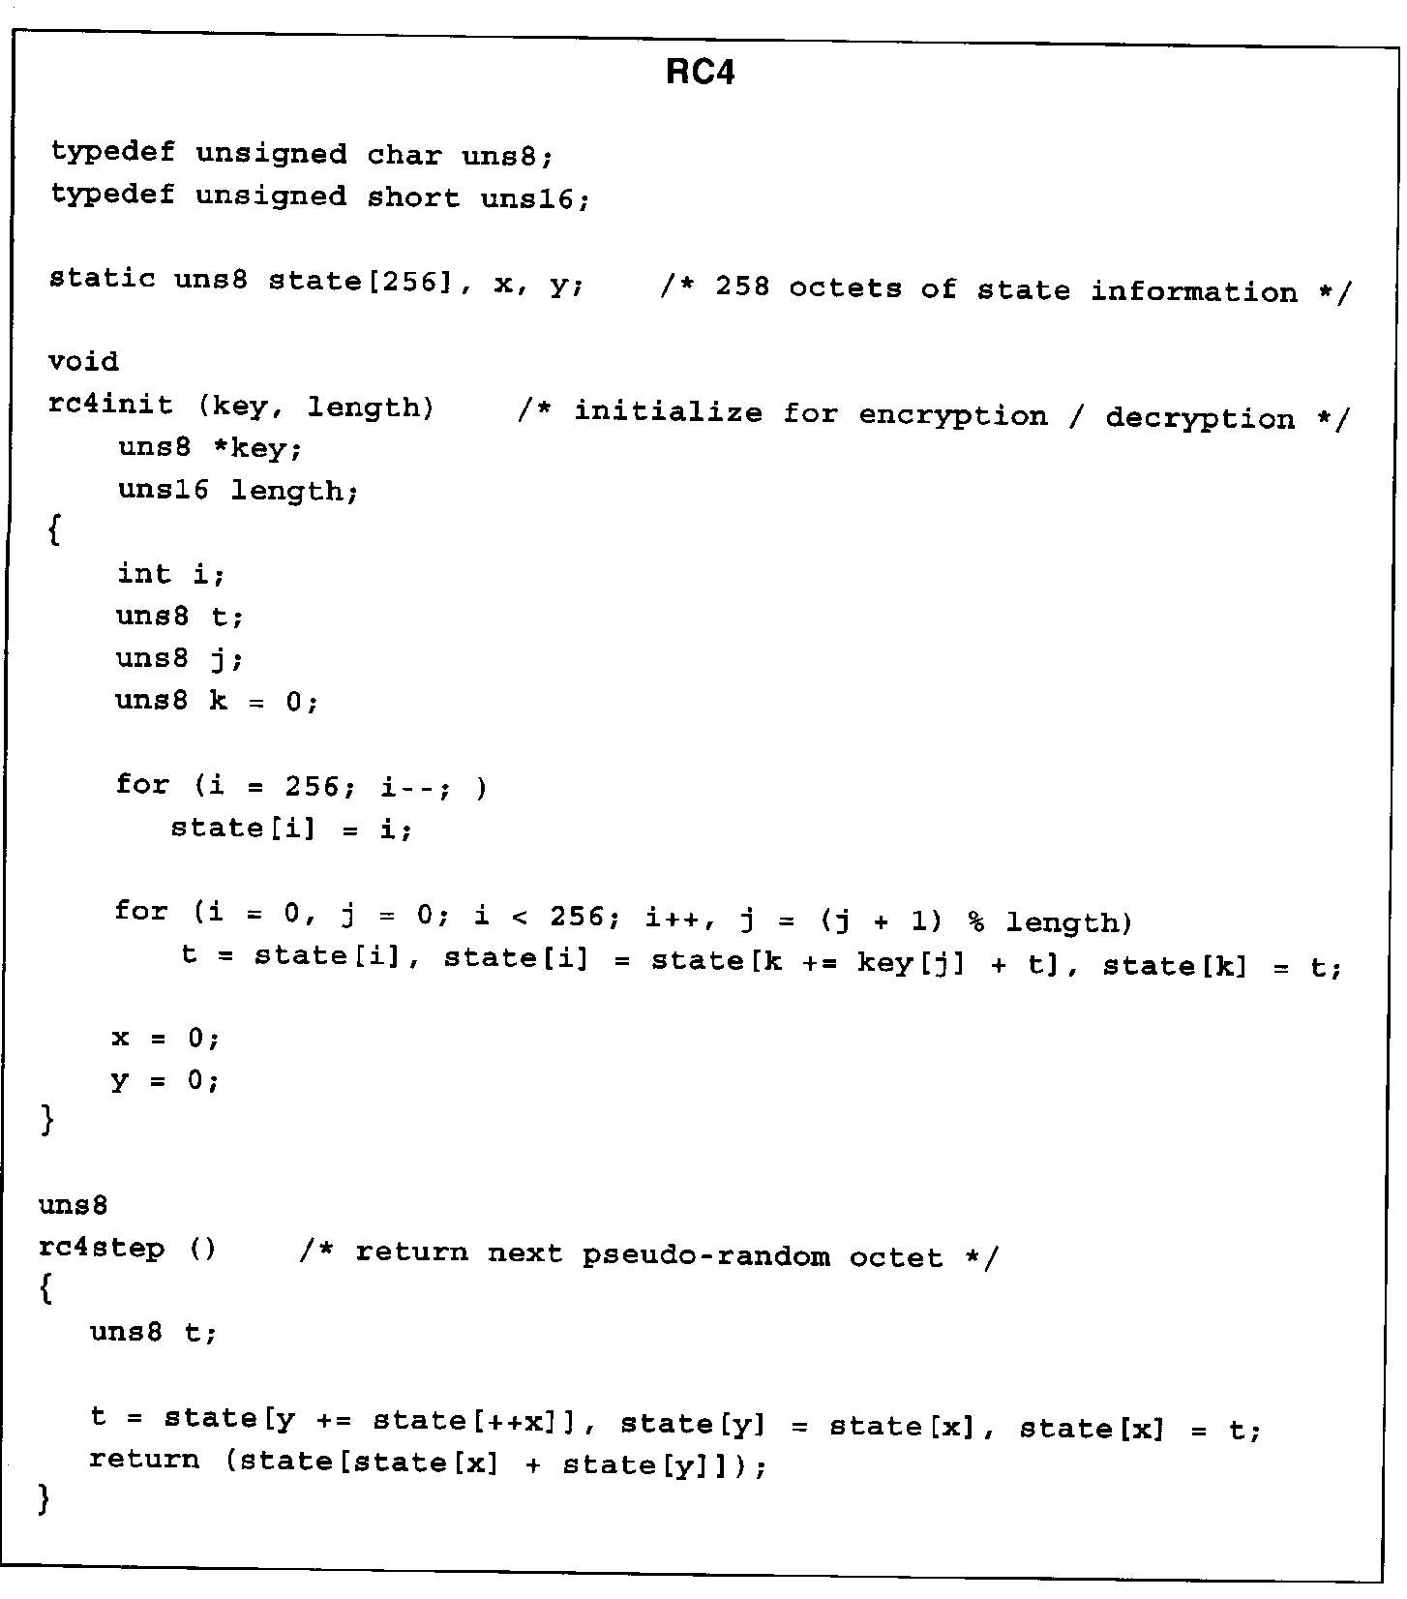
RC4

Slide 47
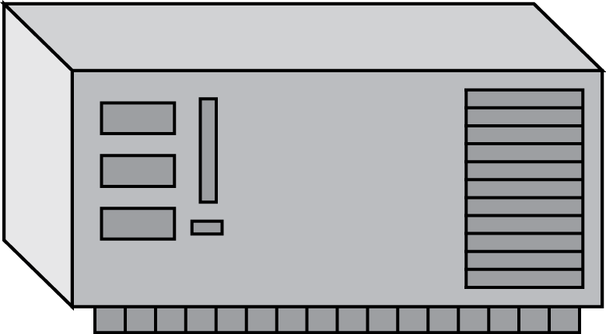





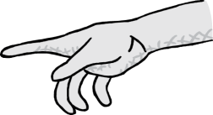
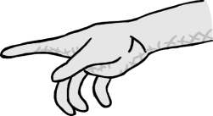
Attacks
Attacker may have
  collection of ciphertexts (ciphertext only attack)
  collection of plaintext/ciphertext pairs (known plaintext attack)
  collection of plaintext/ciphertext pairs for plaintexts selected by the attacker (chosen plaintext attack)
  collection of plaintext/ciphertext pairs for ciphertexts selected by the attacker (chosen ciphertext attack)
Plaintext
Encryption
Algorithm
Ciphertext
Hi, Bob.
Don’t invite Eve to the party!
Love, Alice
(a)
key
Eve
Plaintext
Encryption
Algorithm
Ciphertext
Hi, Bob.
Don’t invite Eve to the party!
Love, Alice
(b)
key
Plaintext
Eve
Ciphertext
ABCDEFG
HIJKLMNO
PQRSTUV
WXYZ.
Encryption
Algorithm
(c)
key
Plaintext
Eve
Ciphertext
Encryption
Algorithm
IJCGA, CAN DO HIFFA GOT TIME.
(d)
001101
110111
key
Eve
Eve

Slide 48
Java Cryptography Architecture
Source
http://docs.oracle.com/javase/7/docs/technotes/guides/security/crypto/CryptoSpec.html
Generate an AES key
KeyGenerator keygen = KeyGenerator.getInstance("AES");
SecretKey aesKey = keygen.generateKey();
Create a cipher object for AES in ECB mode and PKCS5 padding
Cipher aesCipher;
aesCipher = Cipher.getInstance("AES/ECB/PKCS5Padding");
Encrypt
aesCipher.init(Cipher.ENCRYPT_MODE, aesKey);
byte[] plaintext = "My secret message".getBytes();
byte[] ciphertext = aesCipher.doFinal(plaintext);
Decrypt
aesCipher.init(Cipher.DECRYPT_MODE, aesKey);
byte[] plaintext1 = aesCipher.doFinal(ciphertext);

Slide 49
Reference
Cryptography and network security, W. Stallings, Prentice Hall, 2011
Network security: private communication in a public world, C. Kaufman, etc., Prentice Hall, 2002
Computer networking: a top-down approach, J. Kurose and K. Ross, Pearson, 2008
Lecture notes from “computer and network security”, S. Chen, University of Florida

